Slide 1
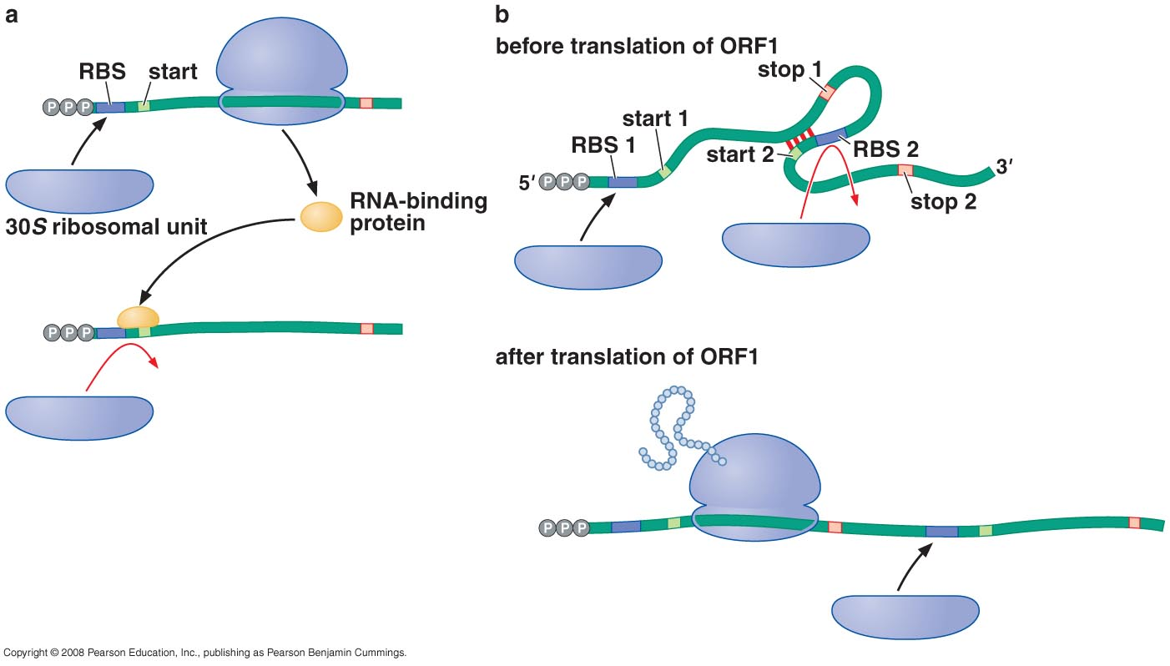
REGULATION OF TRANSLATION
Protein or RNA binding near the ribosome-binding site negatively regulates bacterial translation initiation

Slide 2
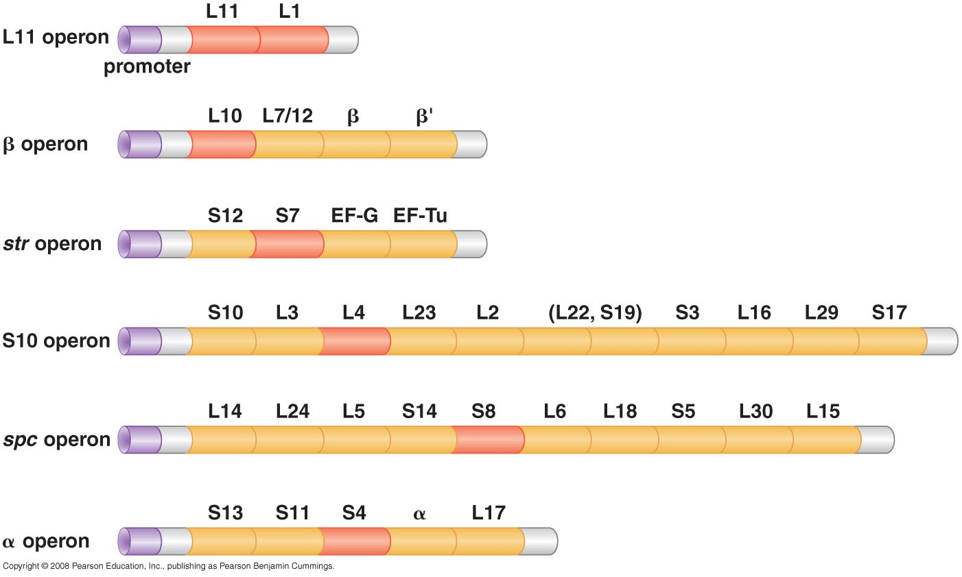
Regulation of prokaryotic translation: Ribosomal proteins are translational repressors of their own synthesis
E. Coli ribosomal protein operons

Slide 3
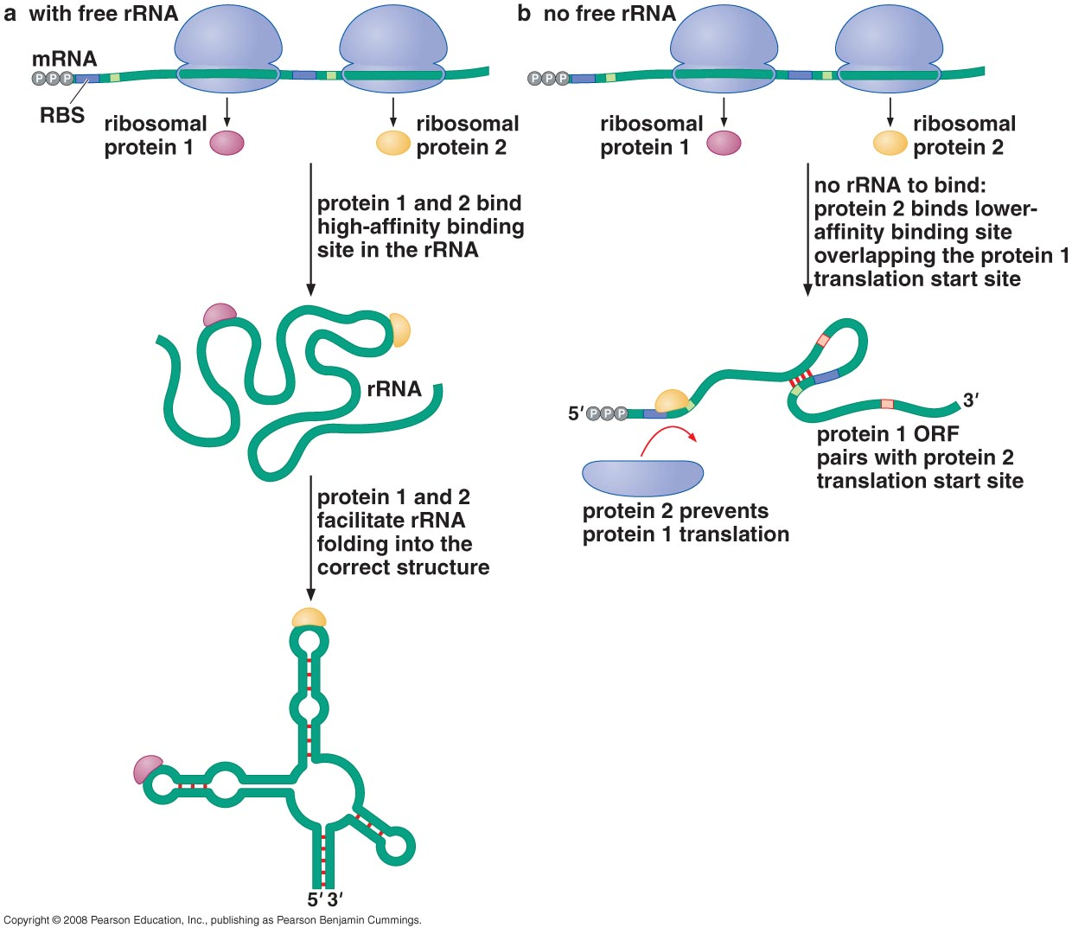
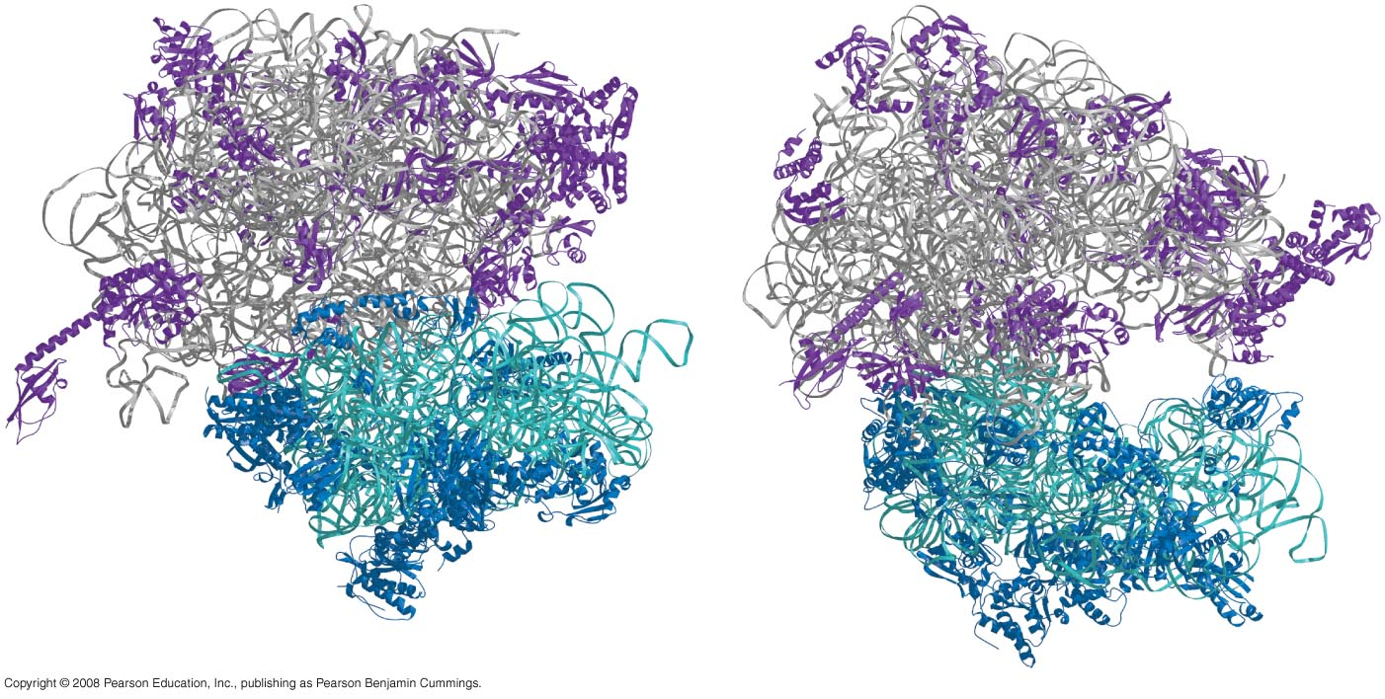
Regulation of ribosomal protein expression

Slide 4
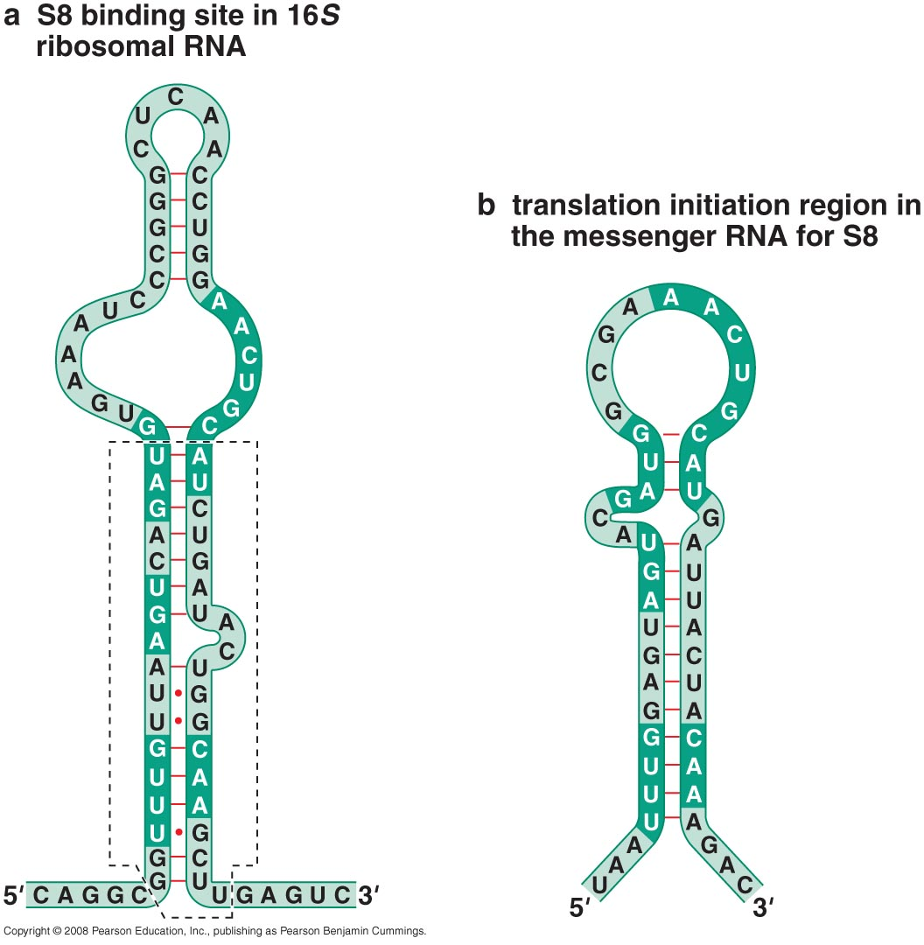
Ribosomal protein S8 binds to 16sRNA and its own mRNA

Slide 5
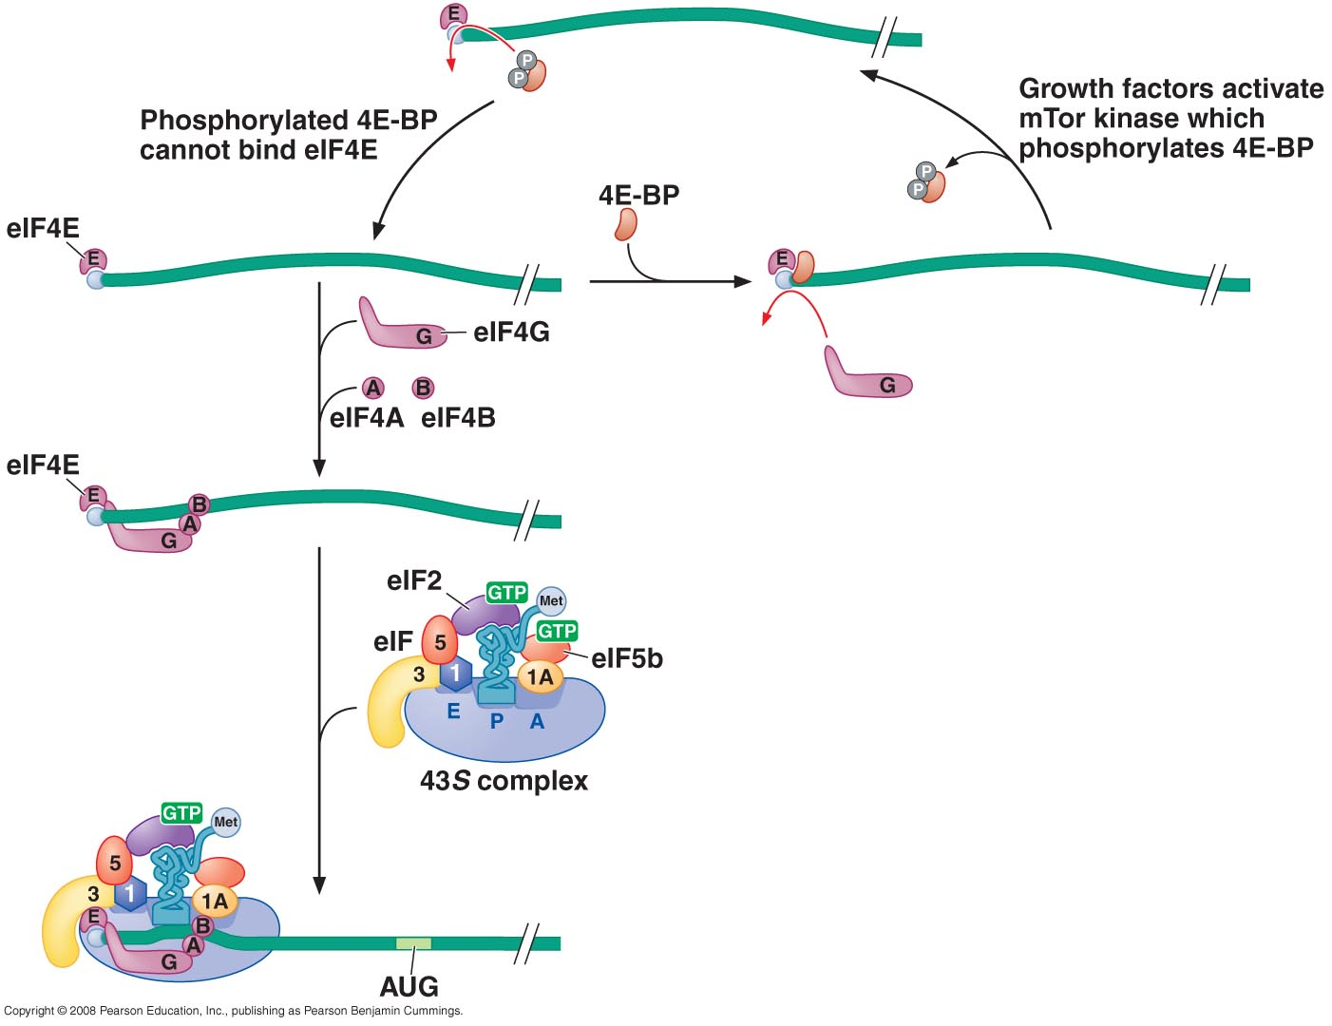
Global regulators of eukaryotic translation target key factors required for mRNA recognition and initiator tRNA ribosome binding

Slide 6
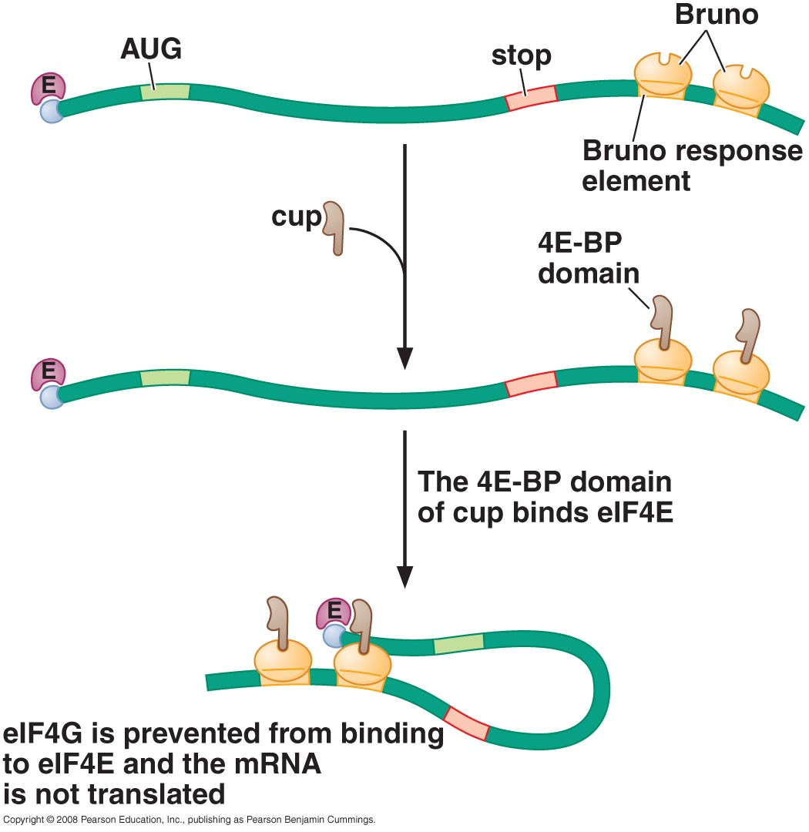
Spatial control of translation by mRNA-specific 4E-Bps

Slide 7
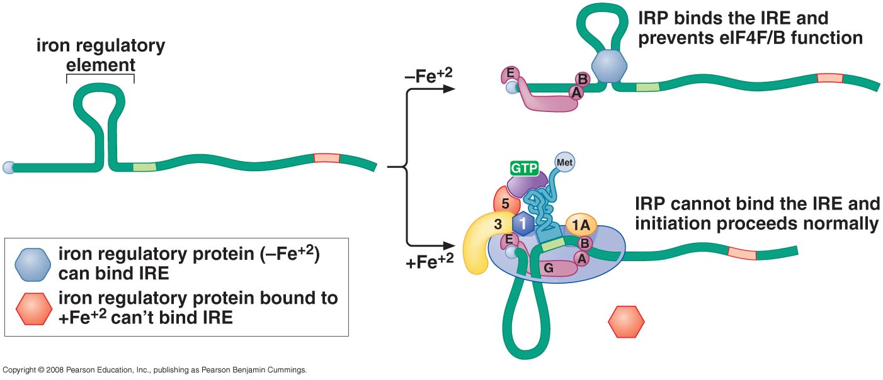
An iron-regulated, RNA-binding protein controls translation of ferritin

Slide 8
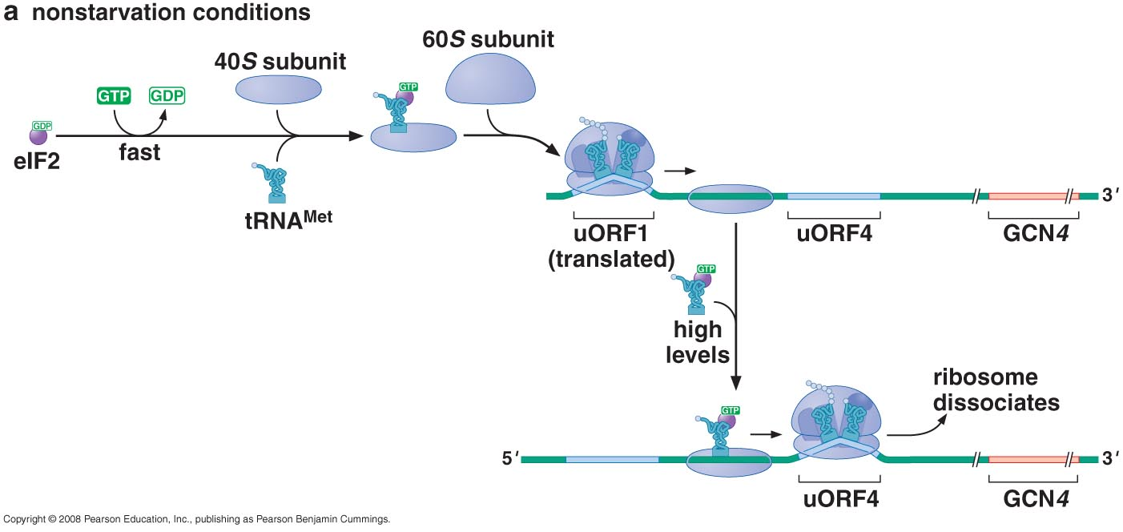
Translation of the yeast transcriptional activator Gcn4 is controlled by short upstream ORFs and ternary complex abundance
Control of Gcn4 in response to AA starvation

Slide 9
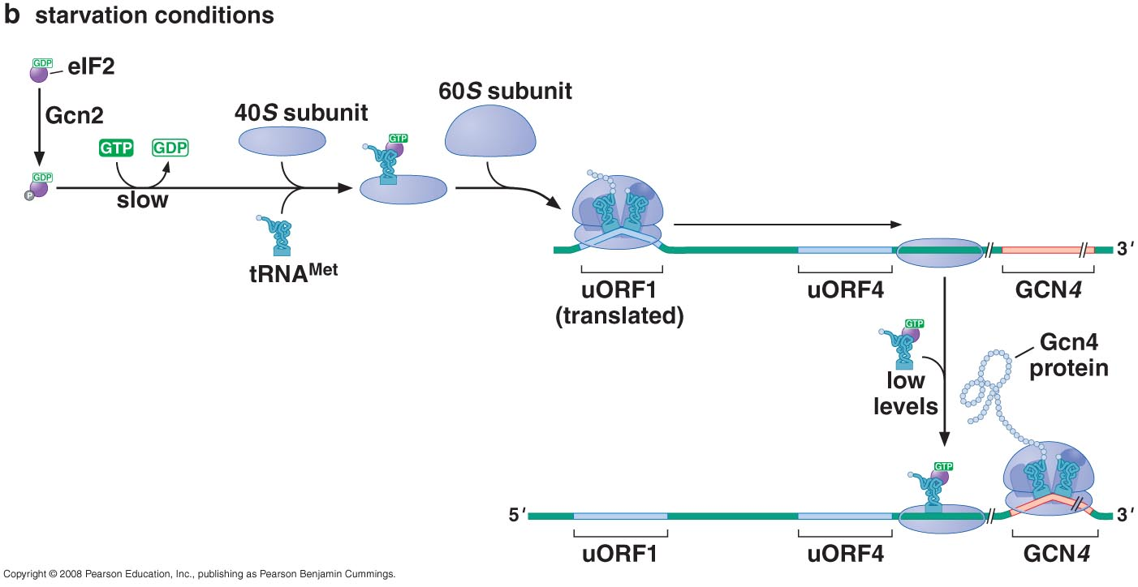

Slide 10
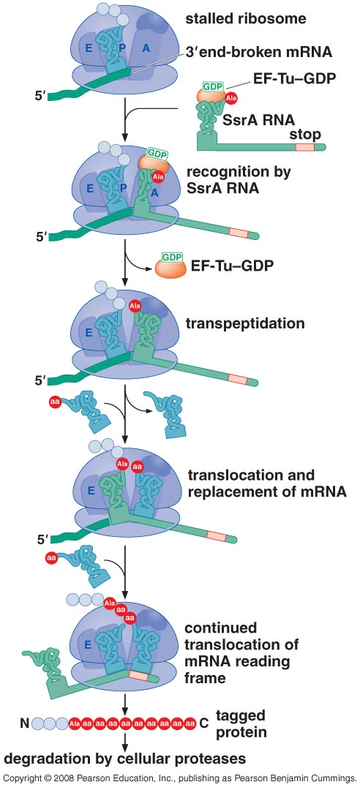
TRANSLATION-DEPENDENT REGULATION OF mRNA and PROTEIN STABILITY
The SsrA RNA ( a tmRNA) rescues ribosomes that translate broken mRNAs

Slide 11
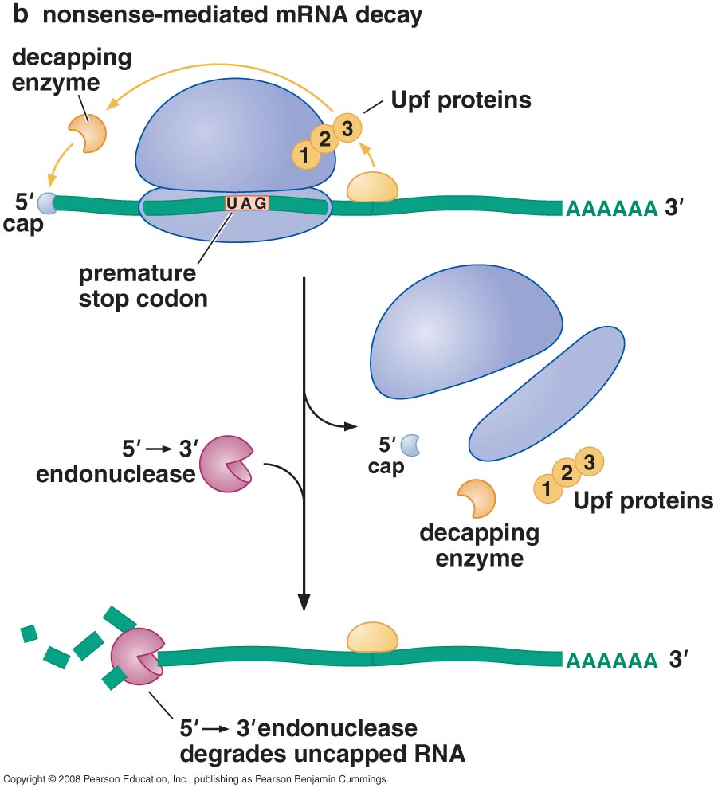
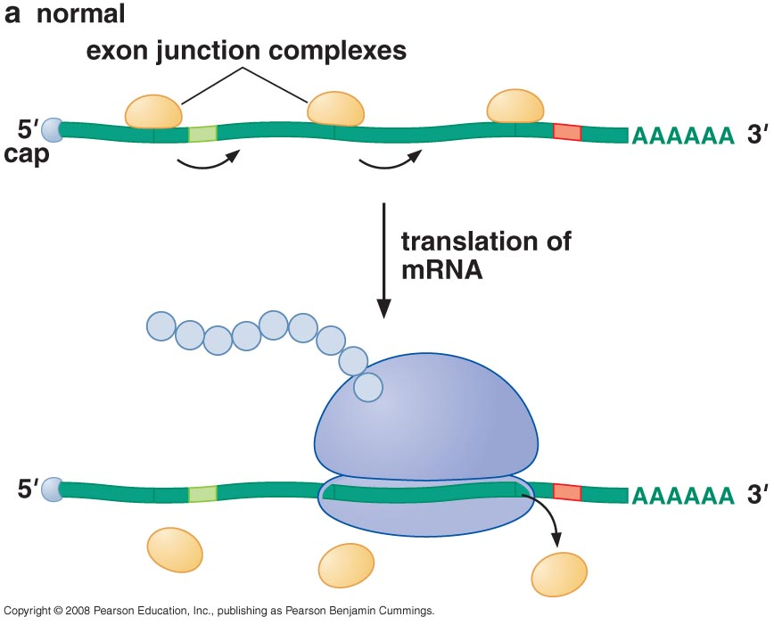
Eukaryotic cells degrade mRNAs that are incomplete or have premature stop codons

Slide 12
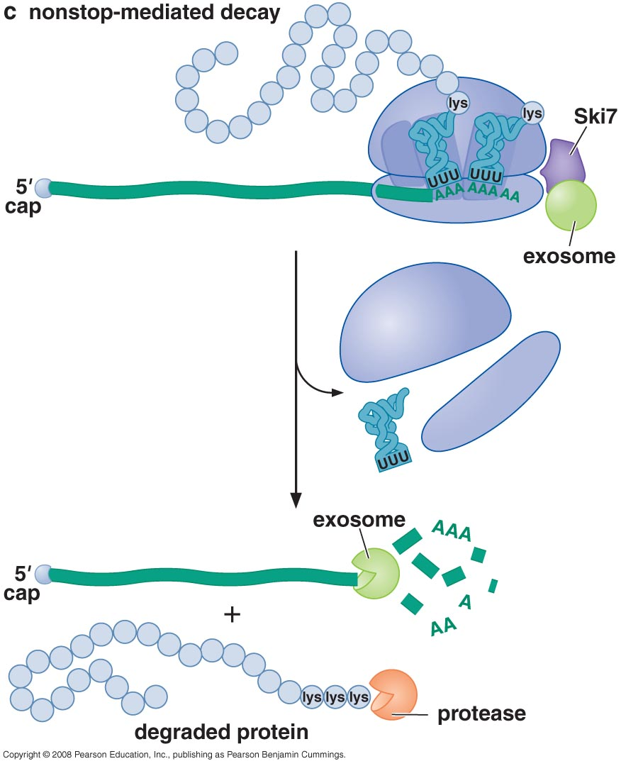

Slide 13
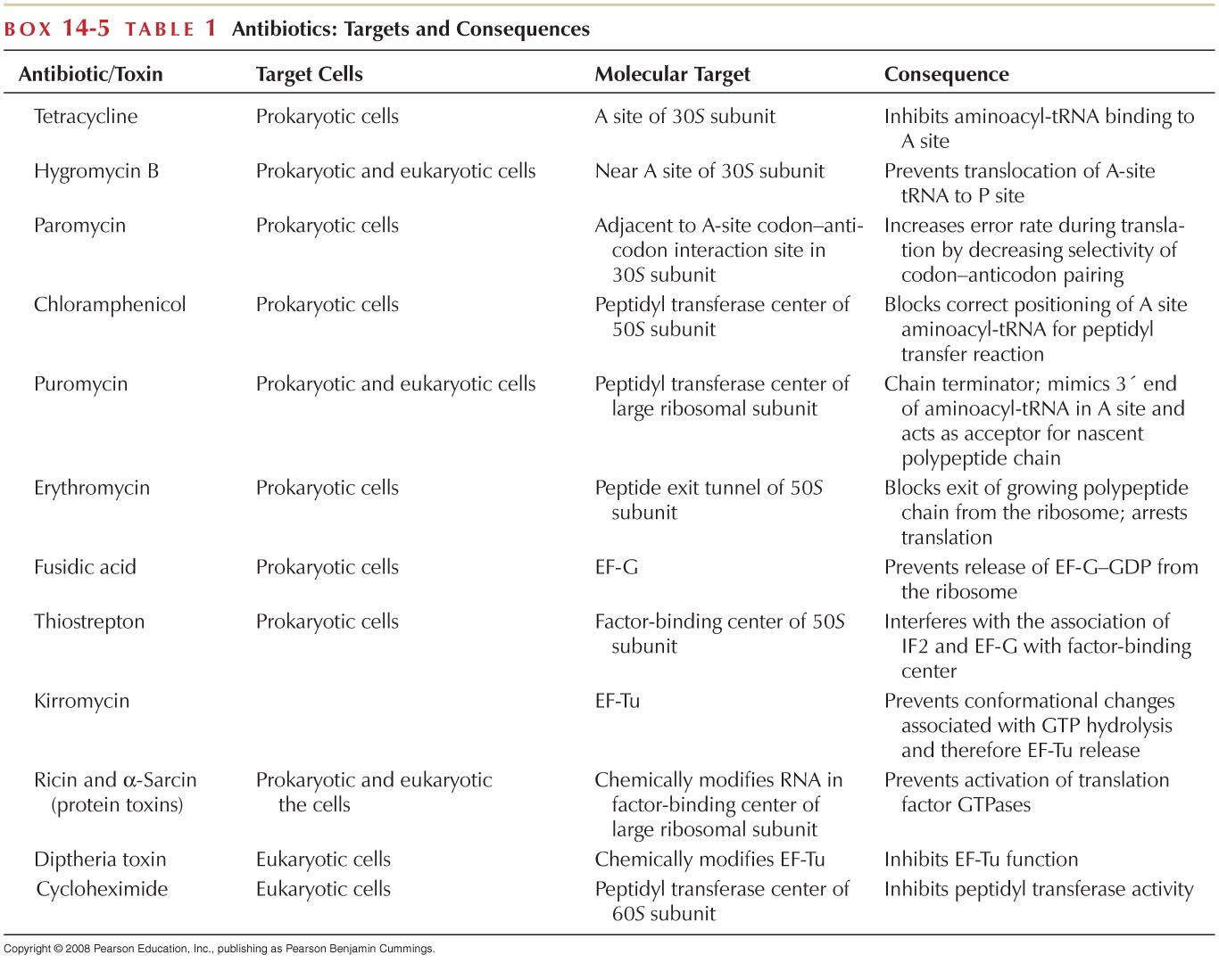

Slide 14
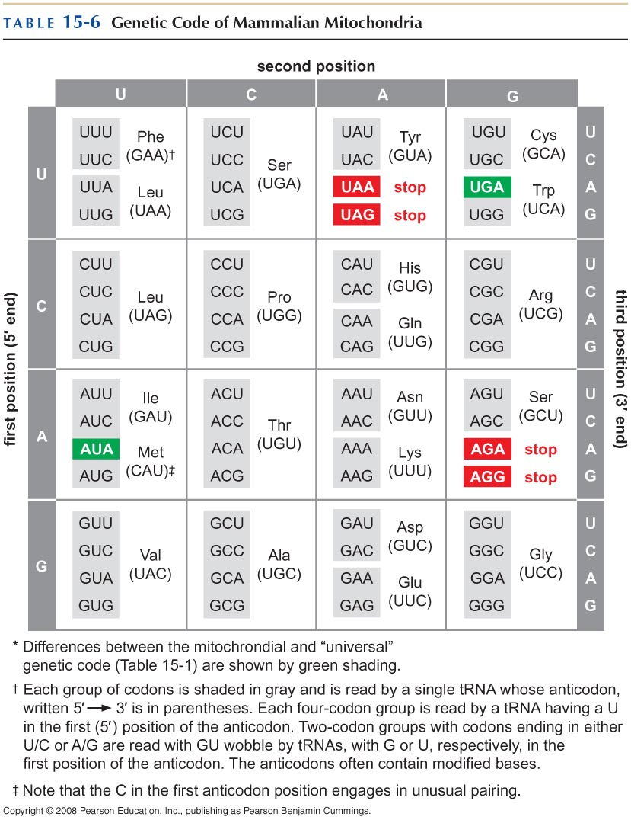
The Genetic Code
THE CODE IS DEGENERATE

Slide 15
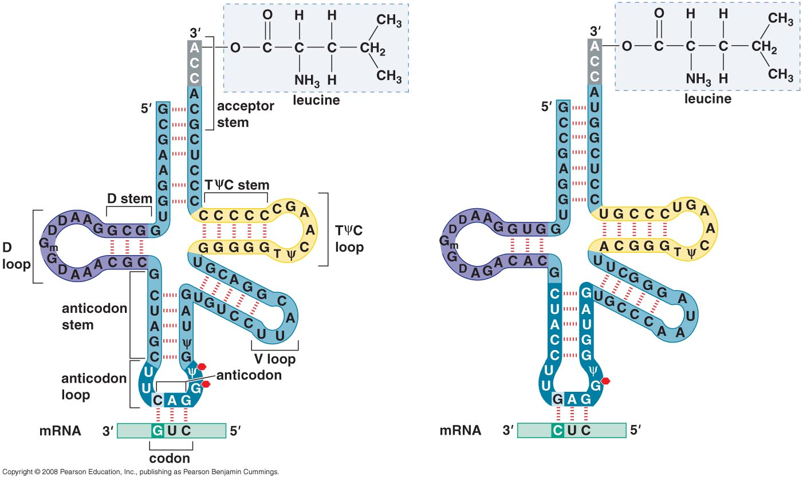
Codon-anticodon pairing of two tRNA-leu molecules

Slide 16
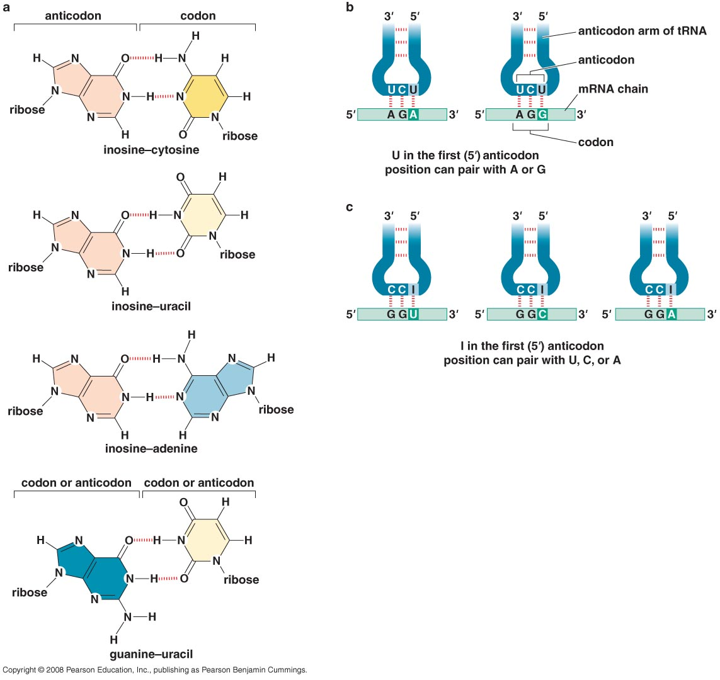
Wobble in the anticodon

Slide 17
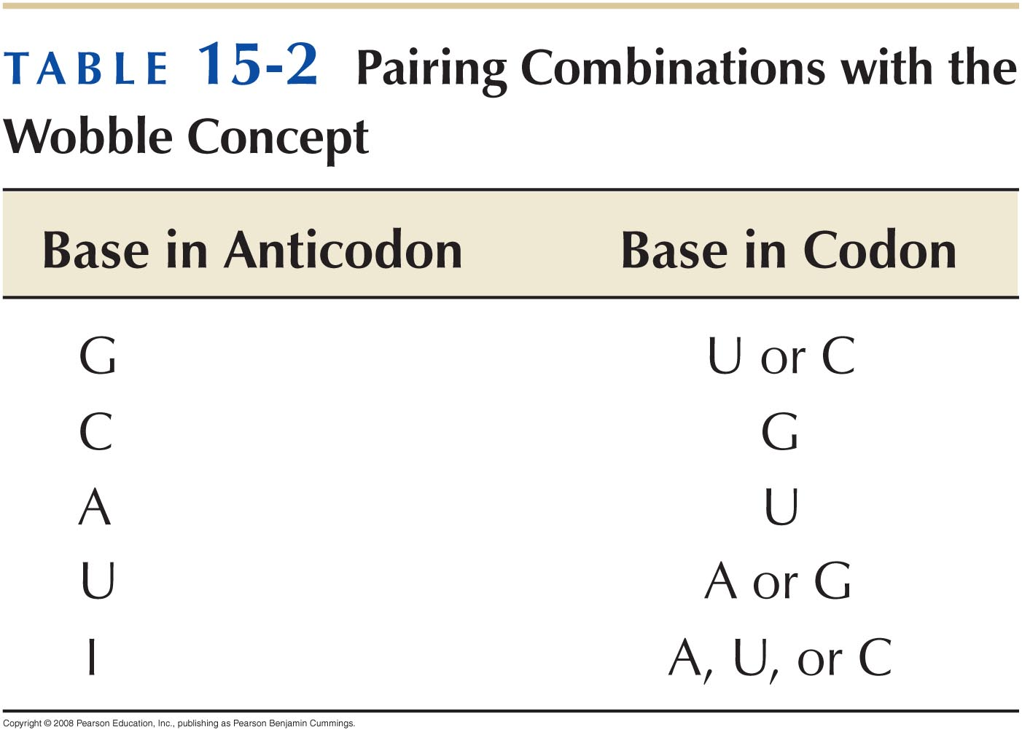

Slide 18
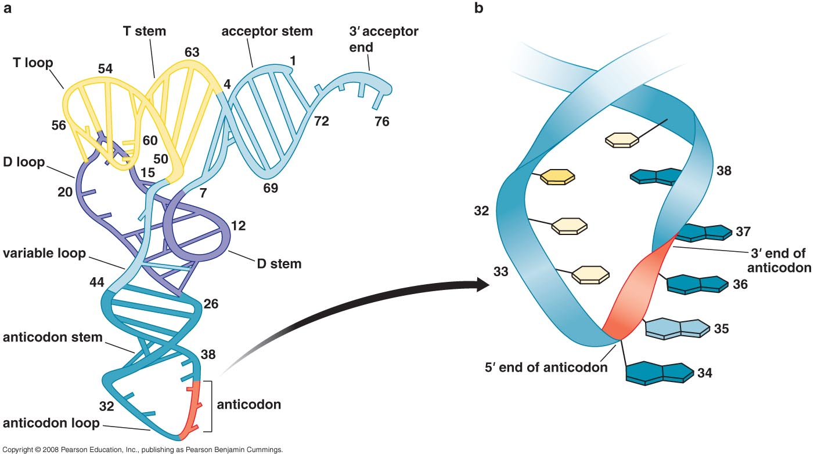
3-D structure of yeast tRNAphe
5’ end of anticodon is free to wobble

Slide 19
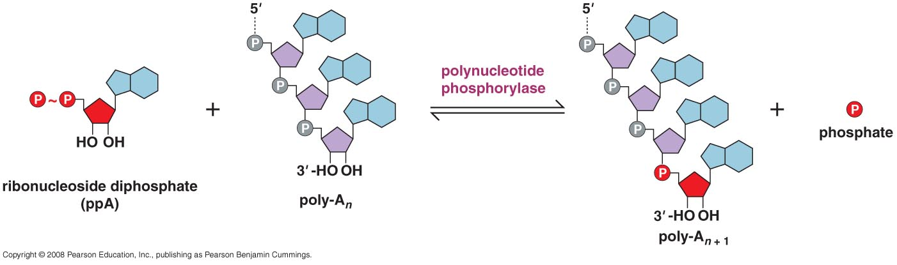
How the code was cracked?
Stimulation of Amino Acid incorporation by synthetic mRNA
Polynucleotide phosphorylase reaction

Slide 20
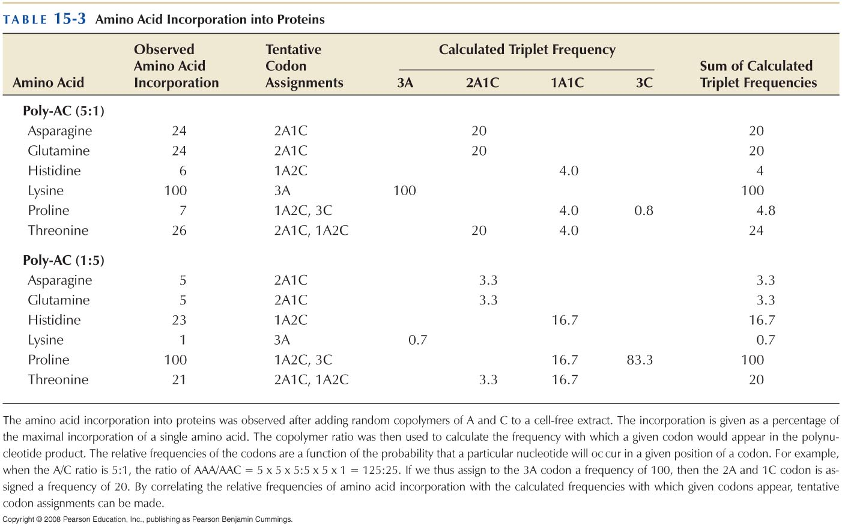
Poly-U codes for polyphenylalanine (Poly-A lysine; Poly-C proline)
Mixed copolymers allowed additional codon assignment

Slide 21
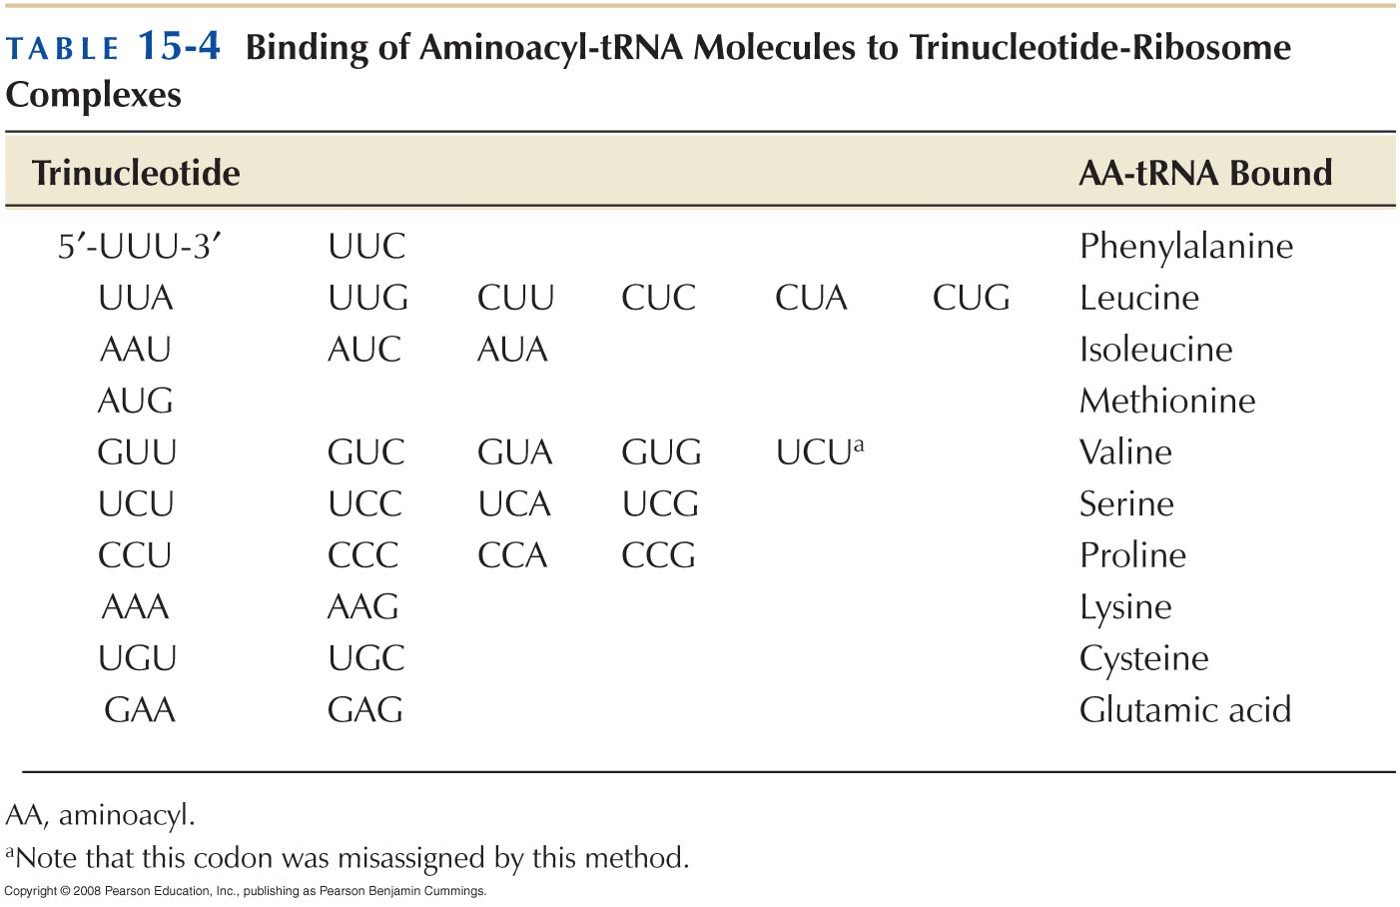
Aminoacyl-tRNA binding to defined trinucleotide codons

Slide 22
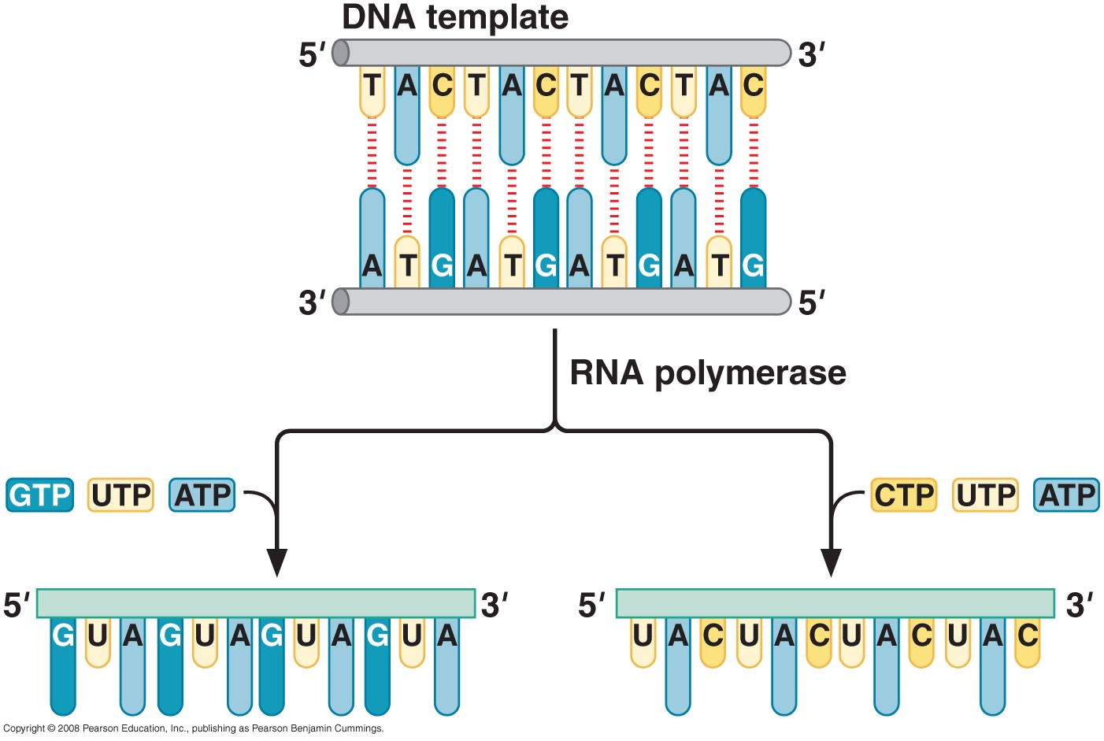
Codon assignments from repeating copolymers

Slide 23
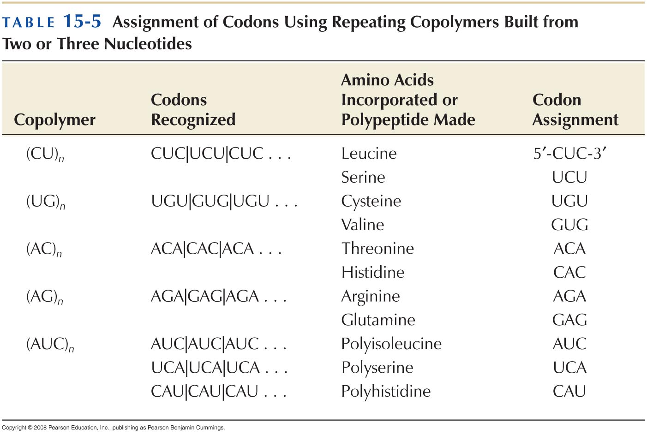

Slide 24
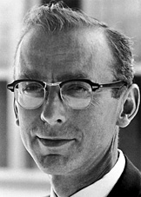
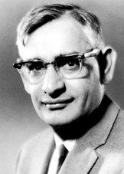
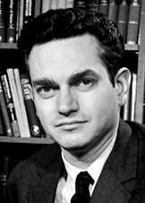
The Nobel Prize in Physiology or Medicine 1968
"for their interpretation of the genetic code and its function in protein synthesis"
Robert W. Holley | Har Gobind Khorana | Marshall W. Nirenberg
1/3 of the prize | 1/3 of the prize | 1/3 of the prize
USA | USA | USA
Cornell University Ithaca, NY, USA | University of Wisconsin Madison, WI, USA | National Institutes of Health Bethesda, MD, USA
b. 1922 d. 1993 | b. 1922 (in Raipur, India) | b. 1927 d. 2010

Slide 25
THREE RULES GORVEN THE GENETIC CODE
The codons are read in a 5’ to 3’ direction
Codons are non-overlapping and the message contains no gap
The message is translated in a fixed reading frame, which is set by the initiation codon

Slide 26
Three kinds of point mutations alter the genetic code
Missense mutation: An alteration that changes a codon specific for one AA to a codon specific for another AA.
Nonsense or stop mutation: an alteration causing a change to a stop codon.
Frameshift mutation: insertions or deletions of one or small number of base pairs that alter the reading frame.

Slide 27
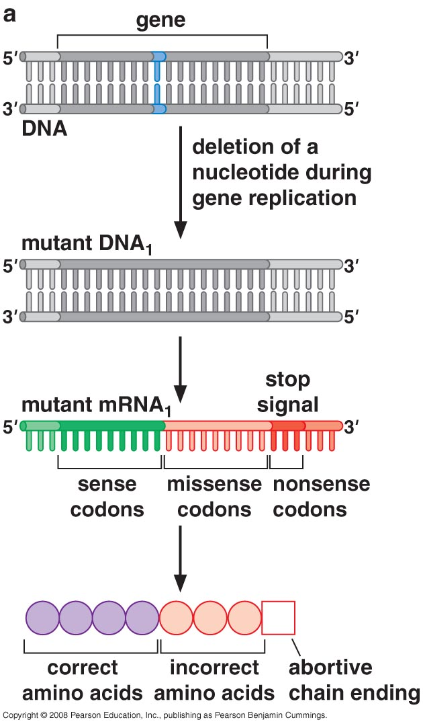
A frameshift mutation

Slide 28
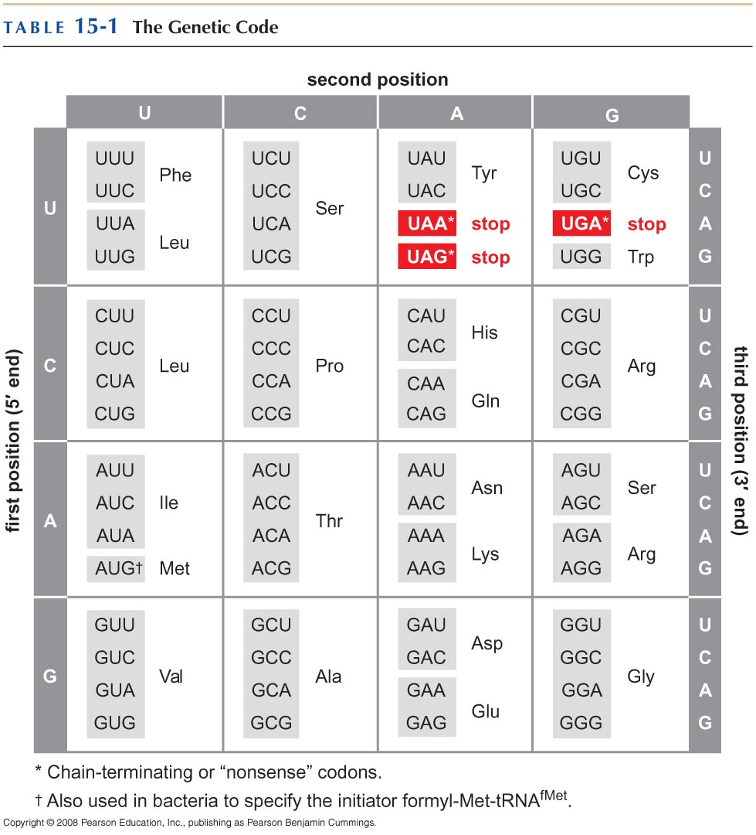
THE CODE IS NEARLY UNIVERSAL

